Slide 1
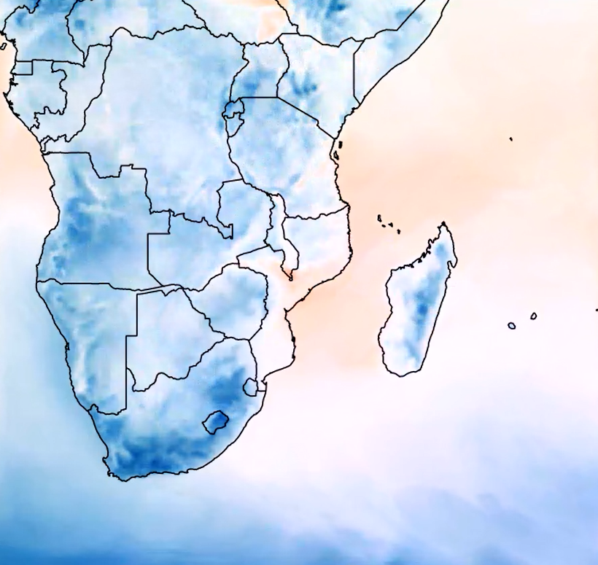
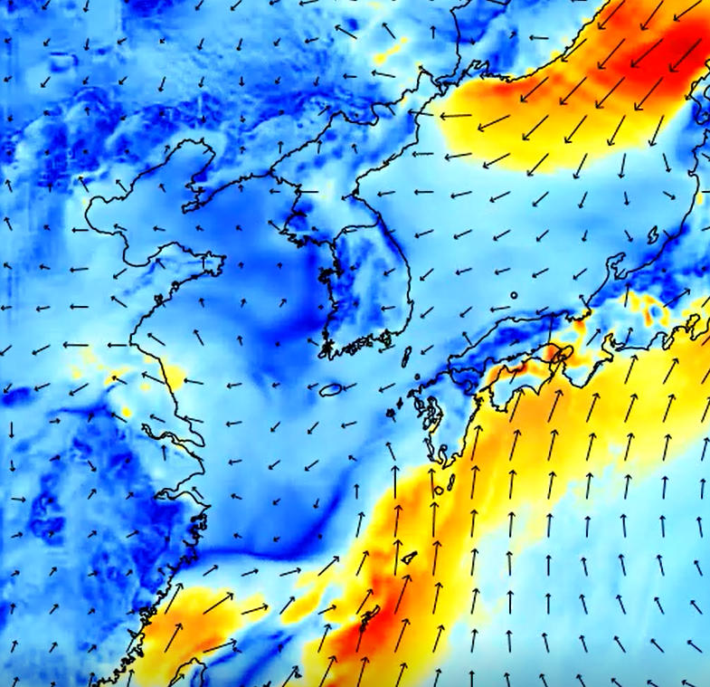
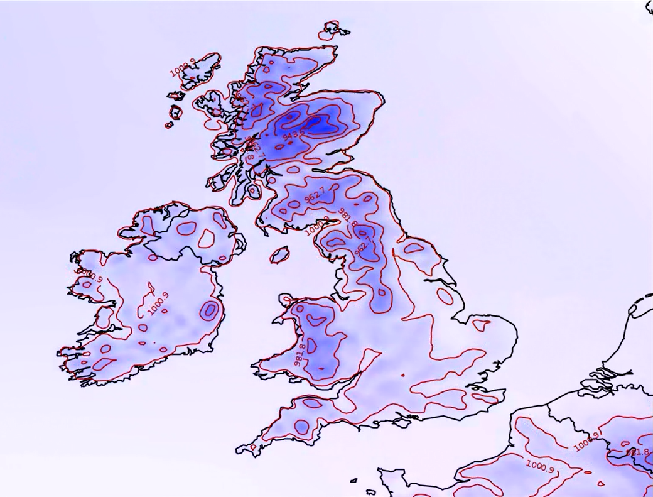
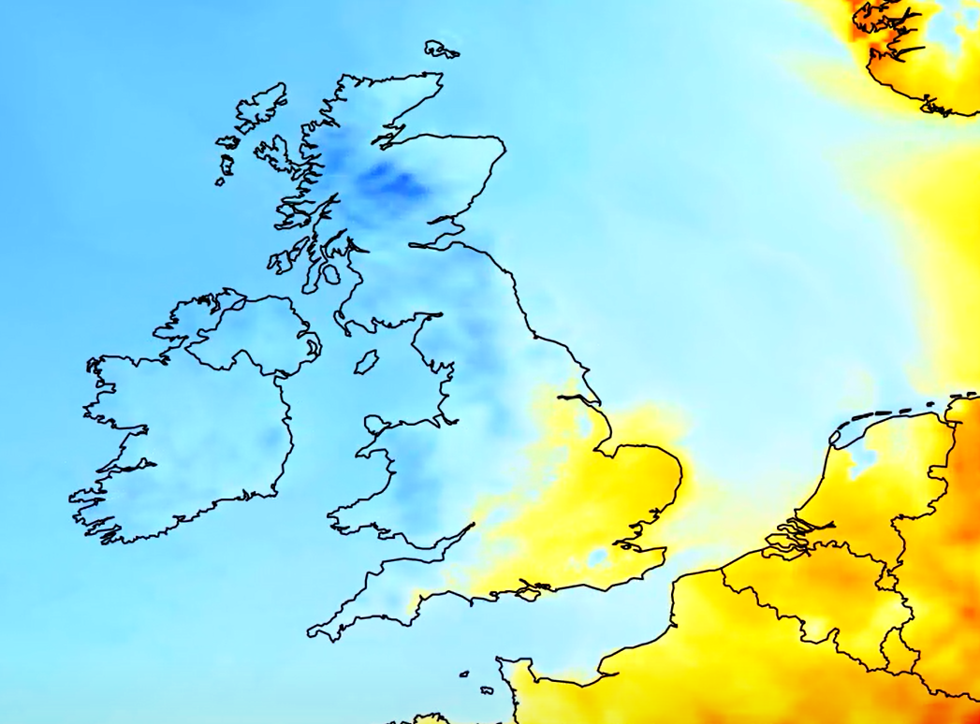
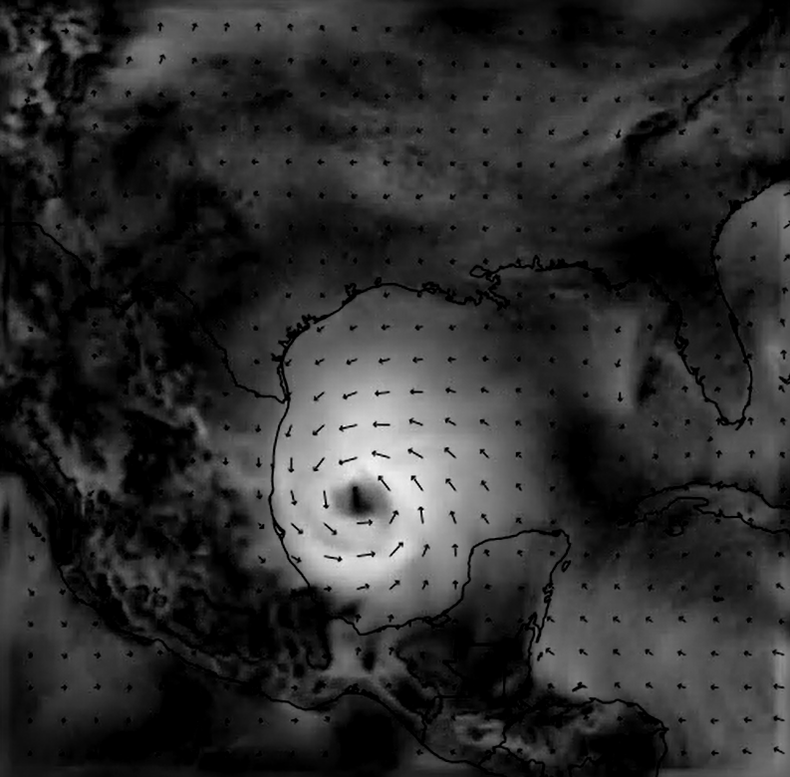
An intro to:
Numerical Weather Prediction
Hitesh Kumar
Mathematics undergraduate colloquium – 23/01/19
Intro to NWP – Front page
Slide: 1/52

Slide 2
Contents:
The fundamental process – start to end
Domain setup + interpolation
Finding IC’s and BC’s
Governing equations
Model discretisation
Some results
Cumulative precipitation – Indian monsoon
Hurricane tracking - Florence
Problems and some solutions
Accuracy of initial conditions + Data assimilation
Post processing + Quantile mapping
Using the software (VM)
Intro to NWP – Contents
Future of NWP – Contents
Slide: 2/52
Slide: 2/

Slide 3
Contents:
The fundamental process – start to end
Domain setup + interpolation
Finding IC’s and BC’s
Governing equations
Model discretisation
Some results
Cumulative precipitation – Indian monsoon
Hurricane tracking - Florence
Problems and some solutions
Accuracy of initial conditions + Data assimilation
Post processing + Quantile mapping
Using the software (VM)
Future of NWP – Contents
Intro to NWP – Domain setup and interpolation
Slide: 2/
Slide: 3/52

Slide 4
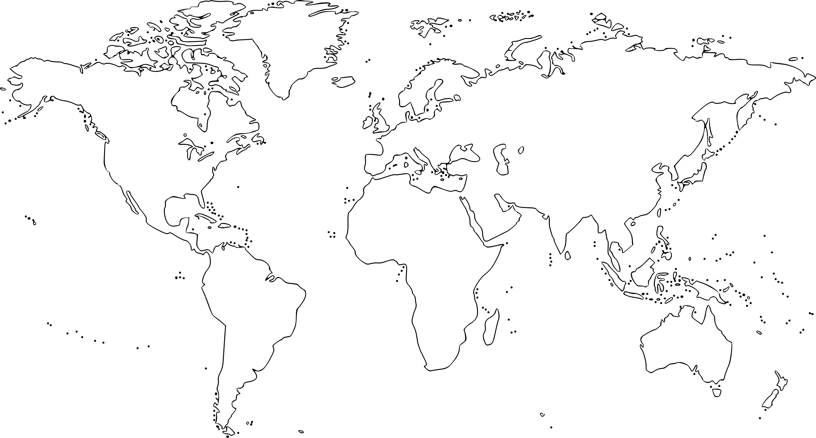
Future of NWP – The fundamental process – Finding IC’s/BC’s
Intro to NWP – Domain setup and interpolation
Slide: 2/
Slide: 4/52

Slide 5
~ 9 km – 40 km
Future of NWP – The fundamental process – Finding IC’s/BC’s
Intro to NWP – Domain setup and interpolation
Slide: 2/
Slide: 5/52

Slide 6
Future of NWP – The fundamental process – Finding IC’s/BC’s
Intro to NWP – Domain setup and interpolation
Slide: 2/
Slide: 6/52

Slide 7
~ 0.3 km – 9 km
Future of NWP – The fundamental process – Finding IC’s/BC’s
Intro to NWP – Domain setup and interpolation
Slide: 2/
Slide: 7/52

Slide 8
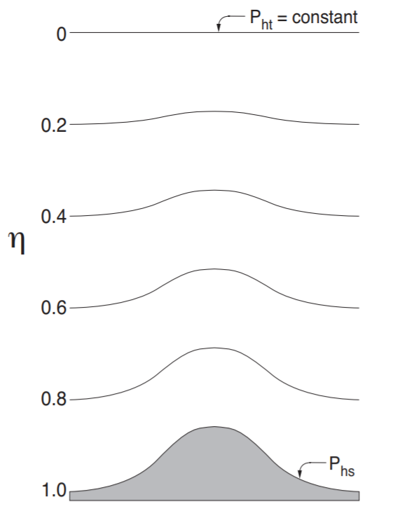
[1]
Intro to NWP – Domain setup and interpolation
Future of NWP – The fundamental process – Variables
Slide: 8/52
Slide: 2/

Slide 9
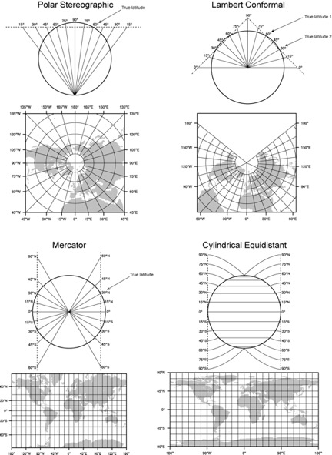
[2]
Future of NWP – The fundamental process – Finding IC’s/BC’s
Intro to NWP – Domain setup and interpolation
Slide: 2/
Slide: 9/52

Slide 10
[3]
Future of NWP – The fundamental process – Finding IC’s/BC’s
Intro to NWP – Domain setup and interpolation
Slide: 2/
Slide: 10/52

Slide 11
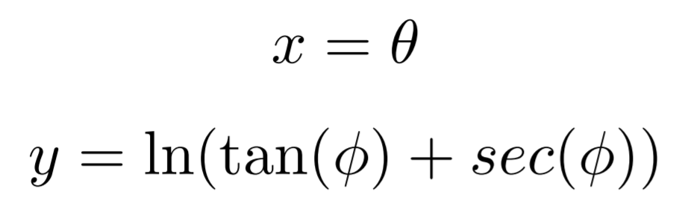
Future of NWP – The fundamental process – Finding IC’s/BC’s
Intro to NWP – Domain setup and interpolation
Slide: 2/
Slide: 11/52

Slide 12
Contents:
The fundamental process – start to end
Domain setup + interpolation
Finding IC’s and BC’s
Governing equations
Model discretisation
Some results
Cumulative precipitation – Indian monsoon
Hurricane tracking - Florence
Problems and some solutions
Accuracy of initial conditions + Data assimilation
Post processing + Quantile mapping
Using the software (VM)
Future of NWP – Contents
Intro to NWP – Finding initial and boundary conditions
Slide: 2/
Slide: 12/52

Slide 13
Horizontal + vertical interpolation
Future of NWP – The fundamental process – Finding IC’s/BC’s
Intro to NWP – Finding initial and boundary conditions
Slide: 2/
Slide: 13/52

Slide 14
Future of NWP – The fundamental process – Finding IC’s/BC’s
Intro to NWP – Finding initial and boundary conditions
Slide: 2/
Slide: 14/52

Slide 15
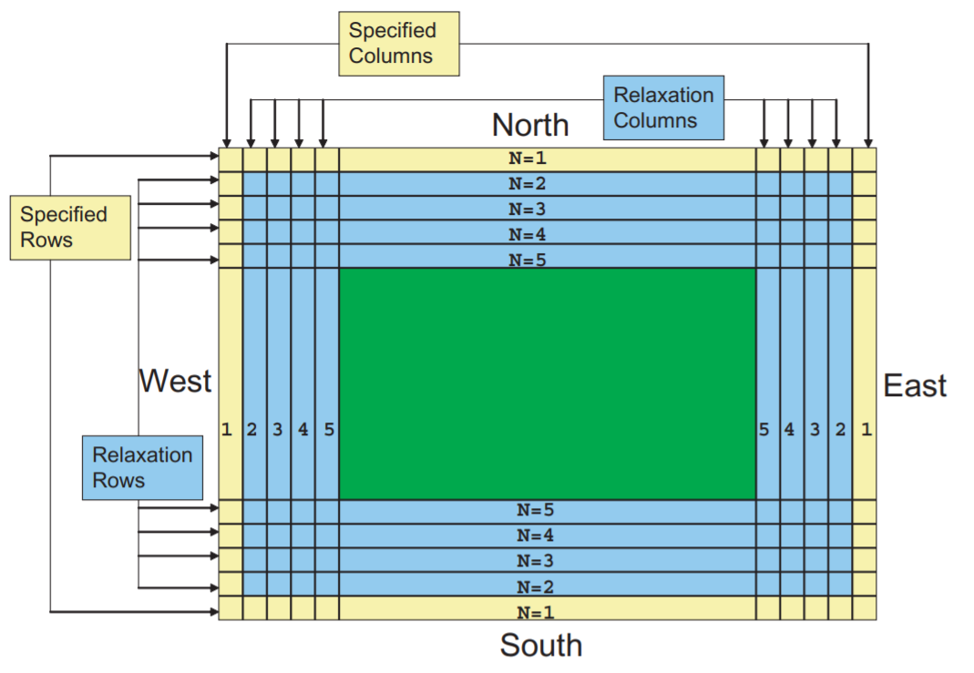
[4]
Future of NWP – The fundamental process – Finding IC’s/BC’s
Intro to NWP – Finding initial and boundary conditions
Slide: 2/
Slide: 15/52

Slide 16
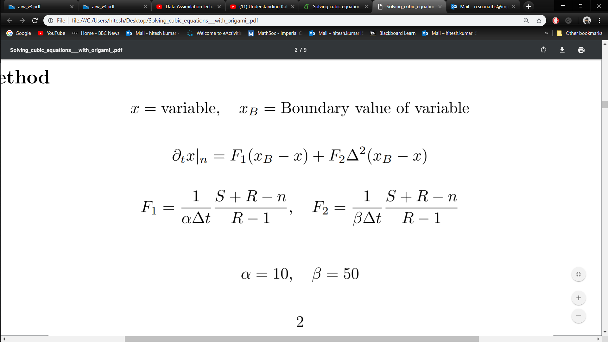
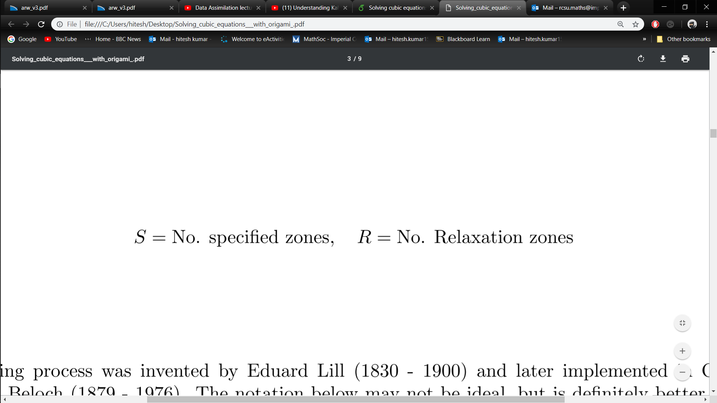
Future of NWP – The fundamental process – Finding IC’s/BC’s
Intro to NWP – Finding initial and boundary conditions
Slide: 2/
Slide: 16/52

Slide 17

Finding Initial and Boundary conditions
NCEP GFS: http://www.ftp.ncep.noaa.gov/data/nccf/com/gfs/prod/
(Or Global Forecast from NCAR RDA: https://rda.ucar.edu/datasets/ds094.0/ if you’re desperate)
Future of NWP – The fundamental process – Finding IC’s/BC’s
Intro to NWP – Finding initial and boundary conditions
Slide: 2/
Slide: 17/52

Slide 18
Domain setup
Future of NWP – The fundamental process – Finding IC’s/BC’s
Intro to NWP – Finding initial and boundary conditions
Slide: 2/
Slide: 18/52

Slide 19
Contents:
The fundamental process – start to end
Domain setup + interpolation
Finding IC’s and BC’s
Governing equations
Model discretisation
Some results
Cumulative precipitation – Indian monsoon
Hurricane tracking - Florence
Problems and some solutions
Accuracy of initial conditions + Data assimilation
Post processing + Quantile mapping
Using the software (VM)
Intro to NWP – Governing equations
Future of NWP – Contents
Slide: 19/52
Slide: 2/

Slide 20
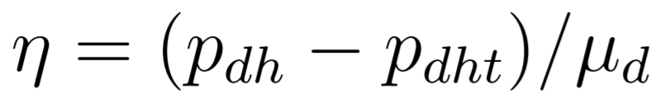
Variables of atmospheric dynamics
Vertical pressure-based coordinate
Intro to NWP – Governing equations
Future of NWP – The fundamental process – Variables
Slide: 20/52
Slide: 2/

Slide 21
[1]
Future of NWP – The fundamental process – Variables
Intro to NWP – Governing equations
Slide: 2/
Slide: 21/52

Slide 22
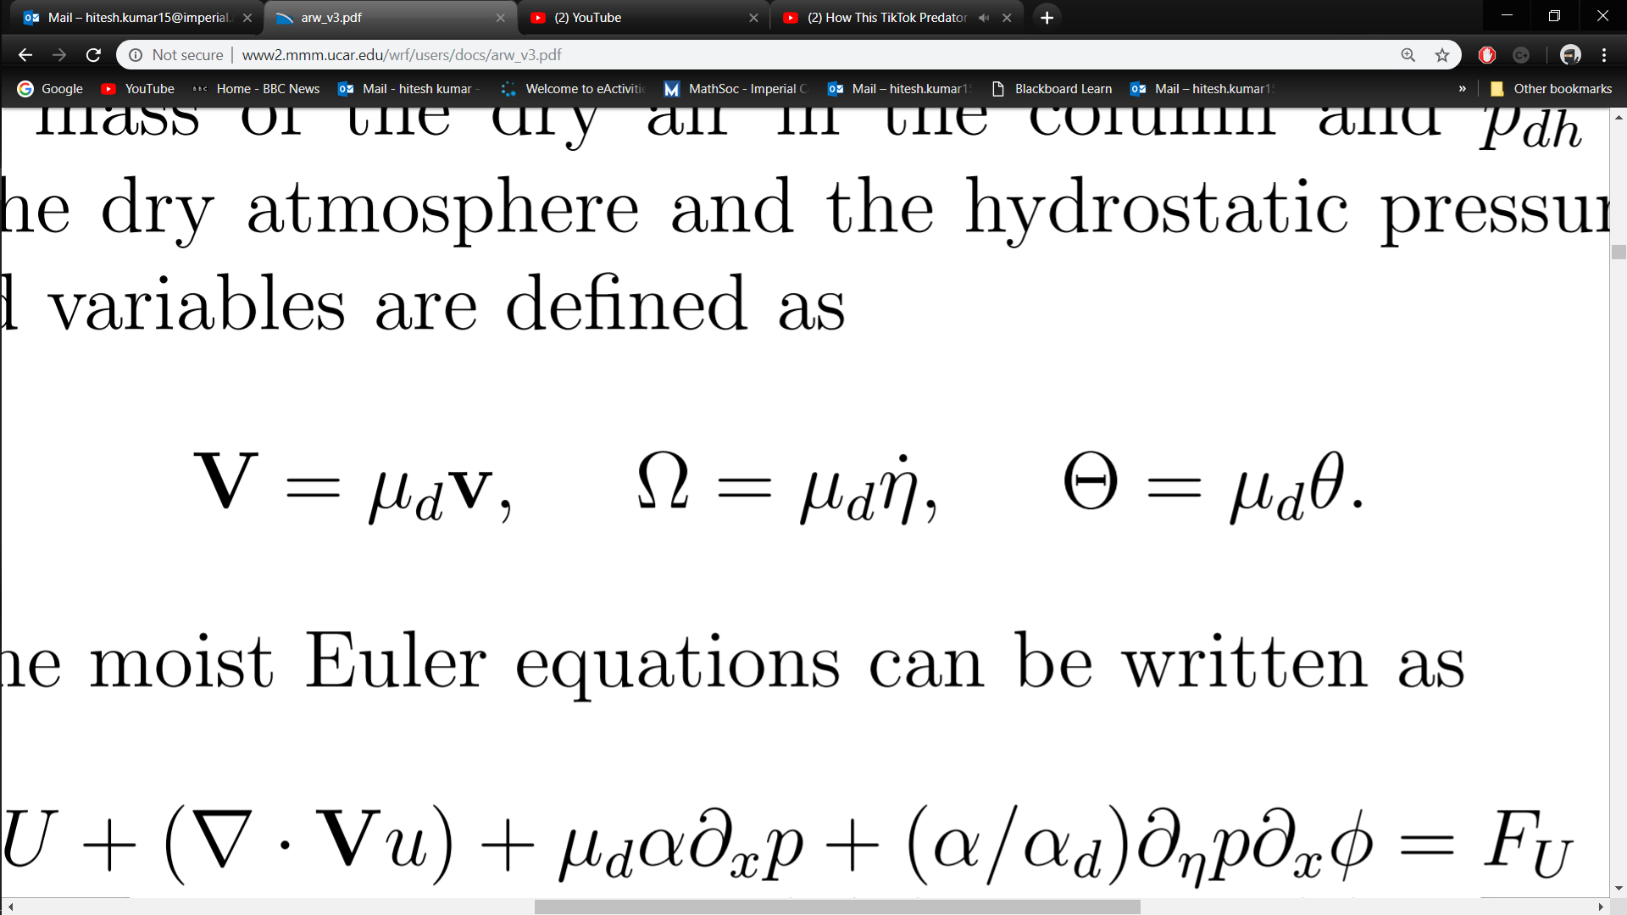
Variables of atmospheric dynamics
Vertical pressure-based coordinate
3D covariant wind velocity
3D contravariant wind velocity
Potential temperature
Intro to NWP – Governing equations
Future of NWP – The fundamental process – Variables
Slide: 22/52
Slide: 2/

Slide 23
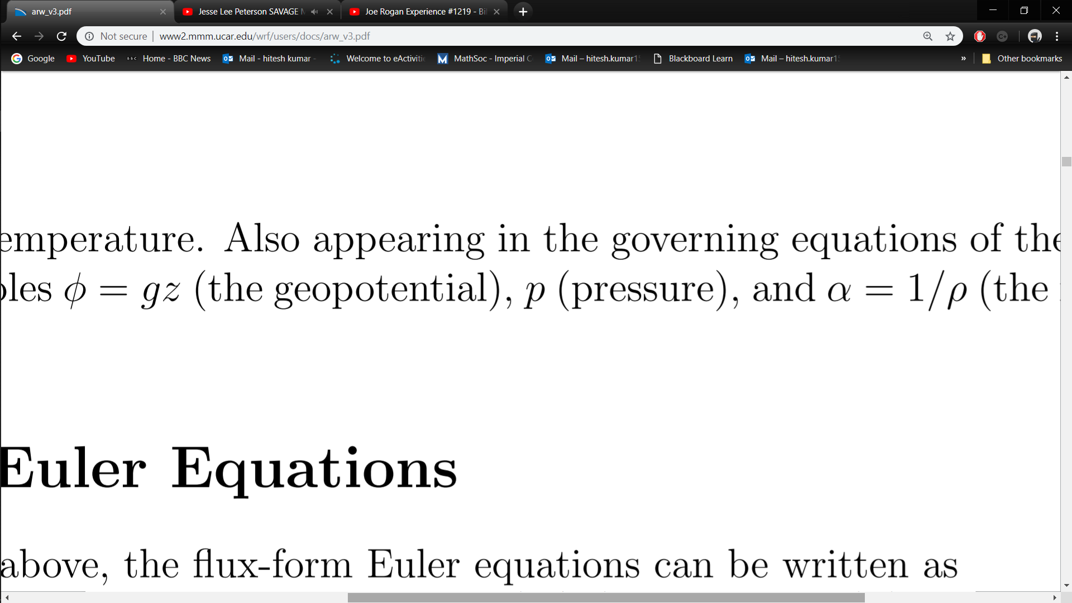
Variables of atmospheric dynamics
Geopotential
Pressure
Inverse density
Future of NWP – The fundamental process – Variables
Intro to NWP – Governing equations
Slide: 2/
Slide: 23/52

Slide 24
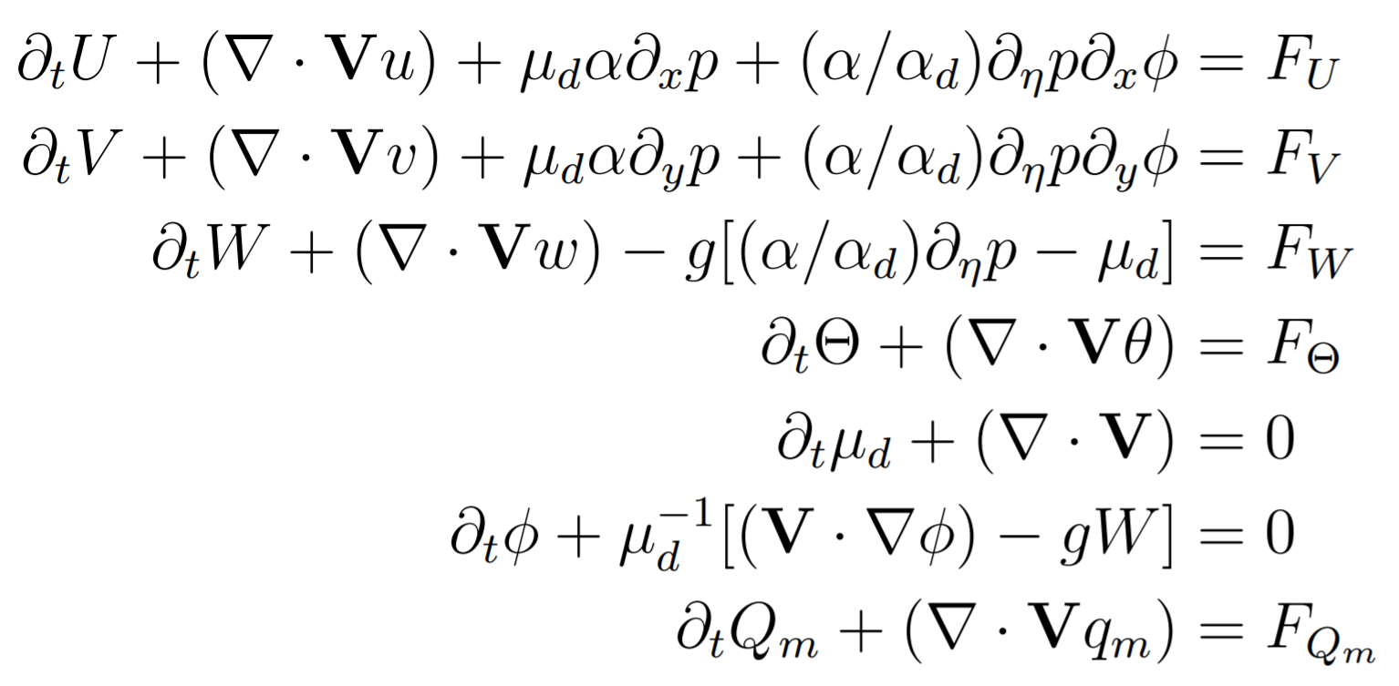
Governing equations of atmospheric dynamics
Moist Euler equations
Intro to NWP – Governing equations
Slide: 24/52
Future of NWP – The fundamental process – Governing equations
Slide: 2/

Slide 25
Contents:
The fundamental process – start to end
Domain setup + interpolation
Finding IC’s and BC’s
Governing equations
Model discretisation
Some results
Cumulative precipitation – Indian monsoon
Hurricane tracking - Florence
Problems and some solutions
Accuracy of initial conditions + Data assimilation
Post processing + Quantile mapping
Using the software (VM)
Future of NWP – Contents
Intro to NWP – Model temporo-spatial discretisation
Slide: 2/
Slide: 25/52

Slide 26
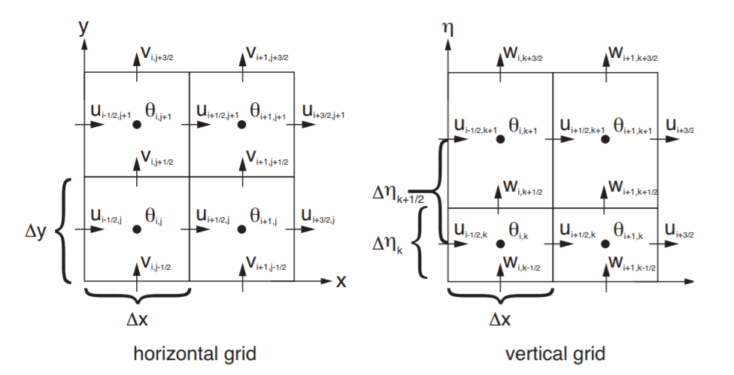
[5]
Future of NWP – The fundamental process – Finding IC’s/BC’s
Intro to NWP – Model temporo-spatial discretisation
Slide: 2/
Slide: 26/52

Slide 27
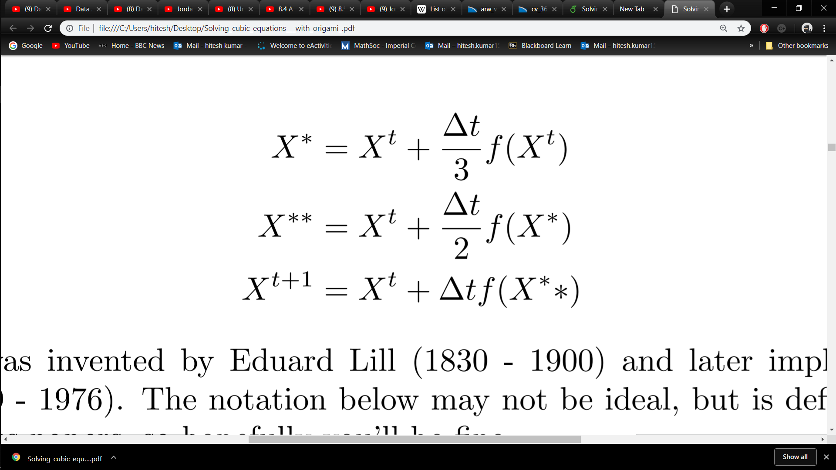
Modified RK3
Future of NWP – The fundamental process – Finding IC’s/BC’s
Intro to NWP – Model temporo-spatial discretisation
Slide: 2/
Slide: 27/52

Slide 28
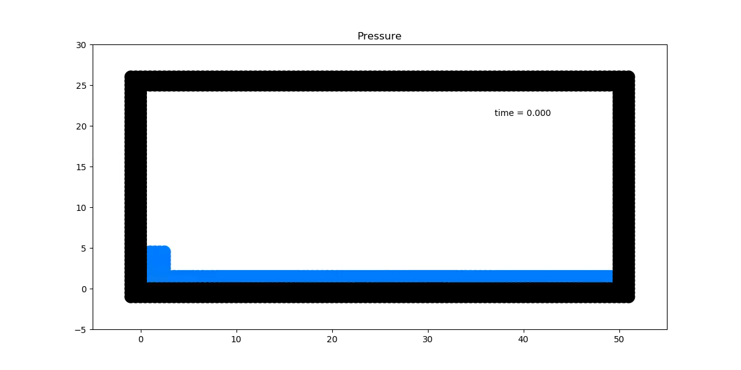
[6]

Slide 29
Contents:
The fundamental process – start to end
Domain setup + interpolation
Finding IC’s and BC’s
Governing equations
Model discretisation
Some results
Cumulative precipitation – Indian monsoon
Hurricane tracking - Florence
Problems and some solutions
Accuracy of initial conditions + Data assimilation
Post processing + Quantile mapping
Using the software (VM)
Future of NWP – Contents
Intro to NWP – Indian monsoon
Slide: 2/
Slide: 29/52

Slide 30
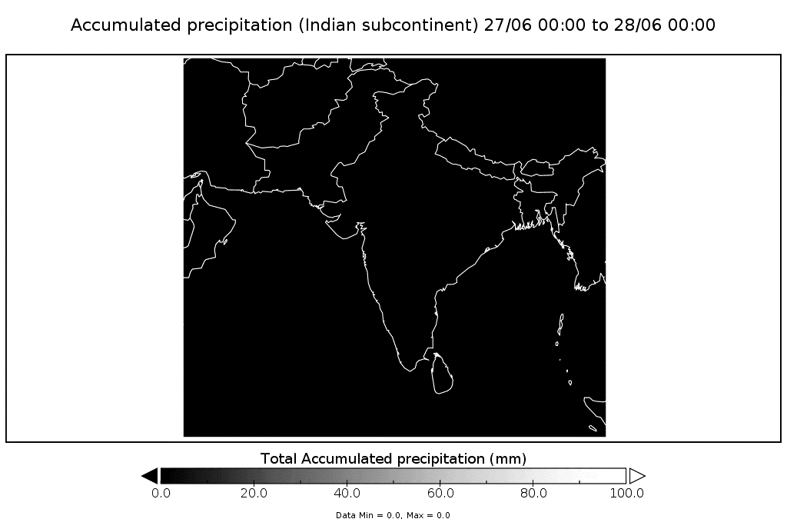

Slide 31
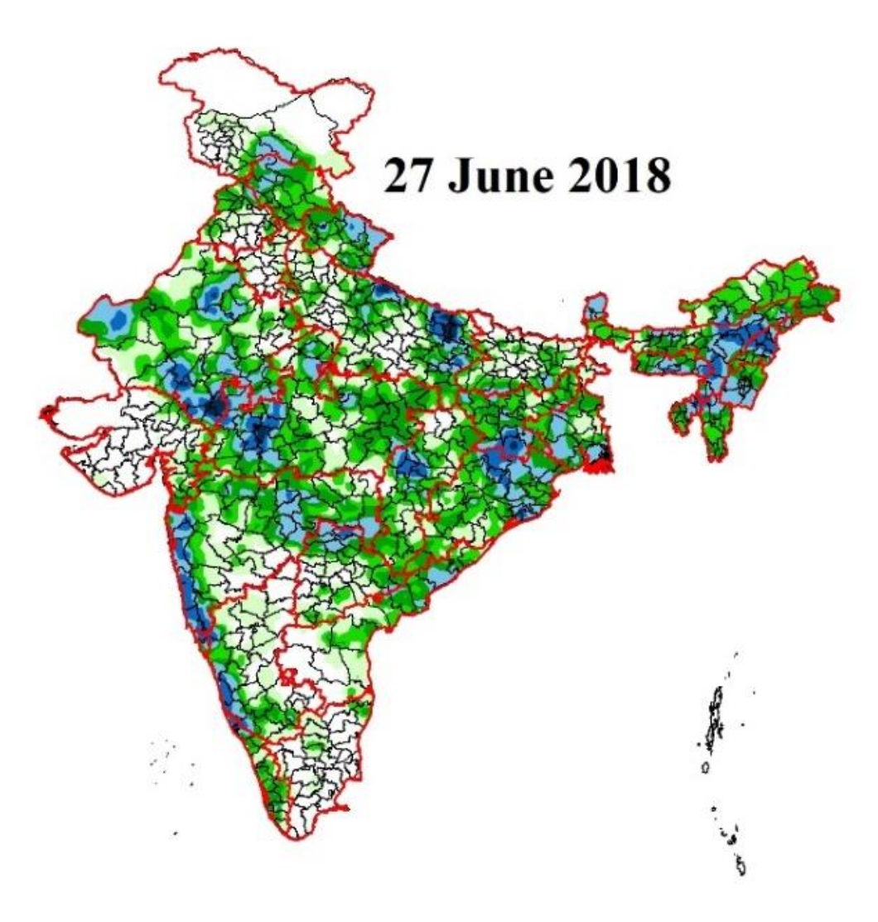
[7]

Slide 32
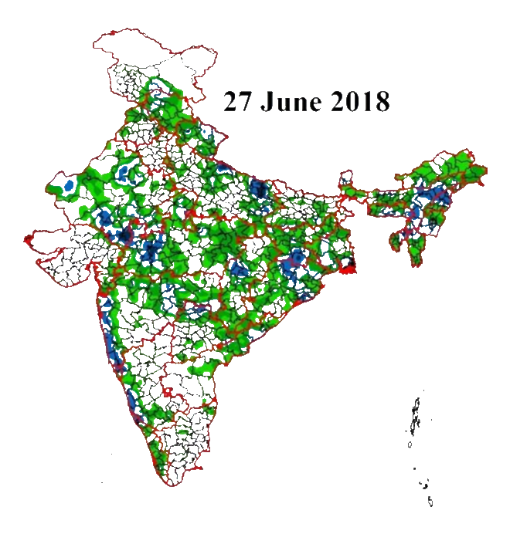

Slide 33
Contents:
The fundamental process – start to end
Domain setup + interpolation
Finding IC’s and BC’s
Governing equations
Model discretisation
Some results
Cumulative precipitation – Indian monsoon
Hurricane tracking - Florence
Problems and some solutions
Accuracy of initial conditions + Data assimilation
Post processing + Quantile mapping
Using the software (VM)
Intro to NWP – Hurricane Florence
Future of NWP – Contents
Slide: 33/52
Slide: 2/

Slide 34
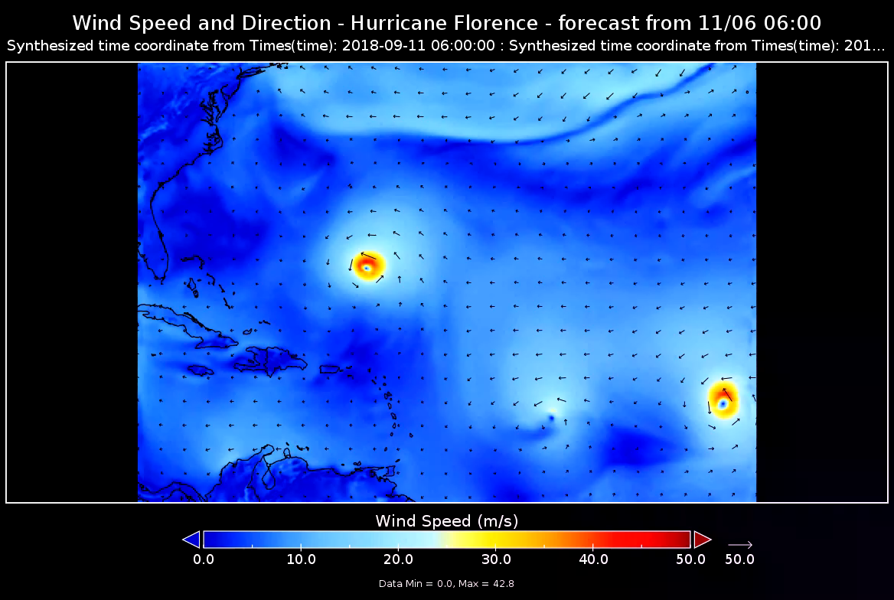

Slide 35
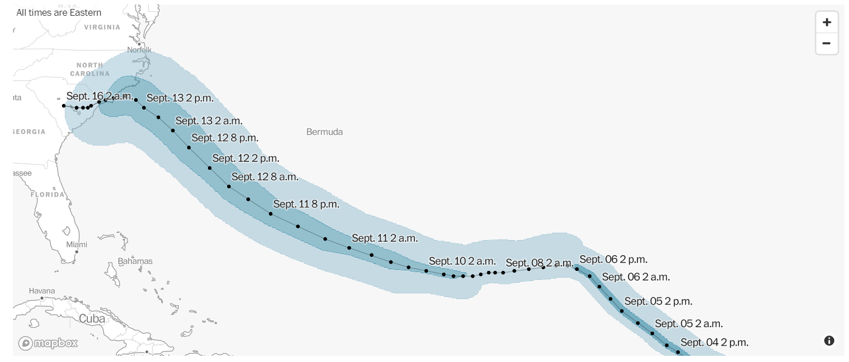
[8]

Slide 36
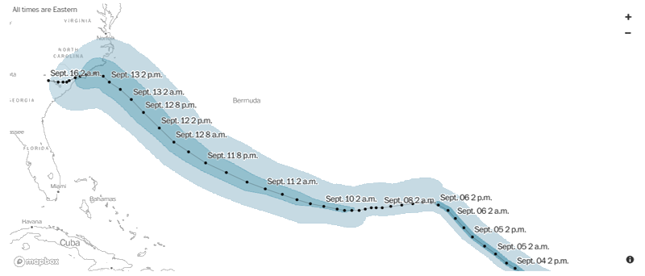

Slide 37
Contents:
The fundamental process – start to end
Domain setup + interpolation
Finding IC’s and BC’s
Governing equations
Model discretisation
Some results
Cumulative precipitation – Indian monsoon
Hurricane tracking - Florence
Problems and some solutions
Accuracy of initial conditions + Data assimilation
Post processing + Quantile mapping
Using the software (VM)
Future of NWP – Contents
Intro to NWP – Data assimilation
Slide: 2/
Slide: 37/52

Slide 38
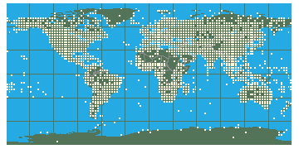
[9]
Intro to NWP – Data assimilation
Future of NWP – Contents
Slide: 38/52
Slide: 2/

Slide 39
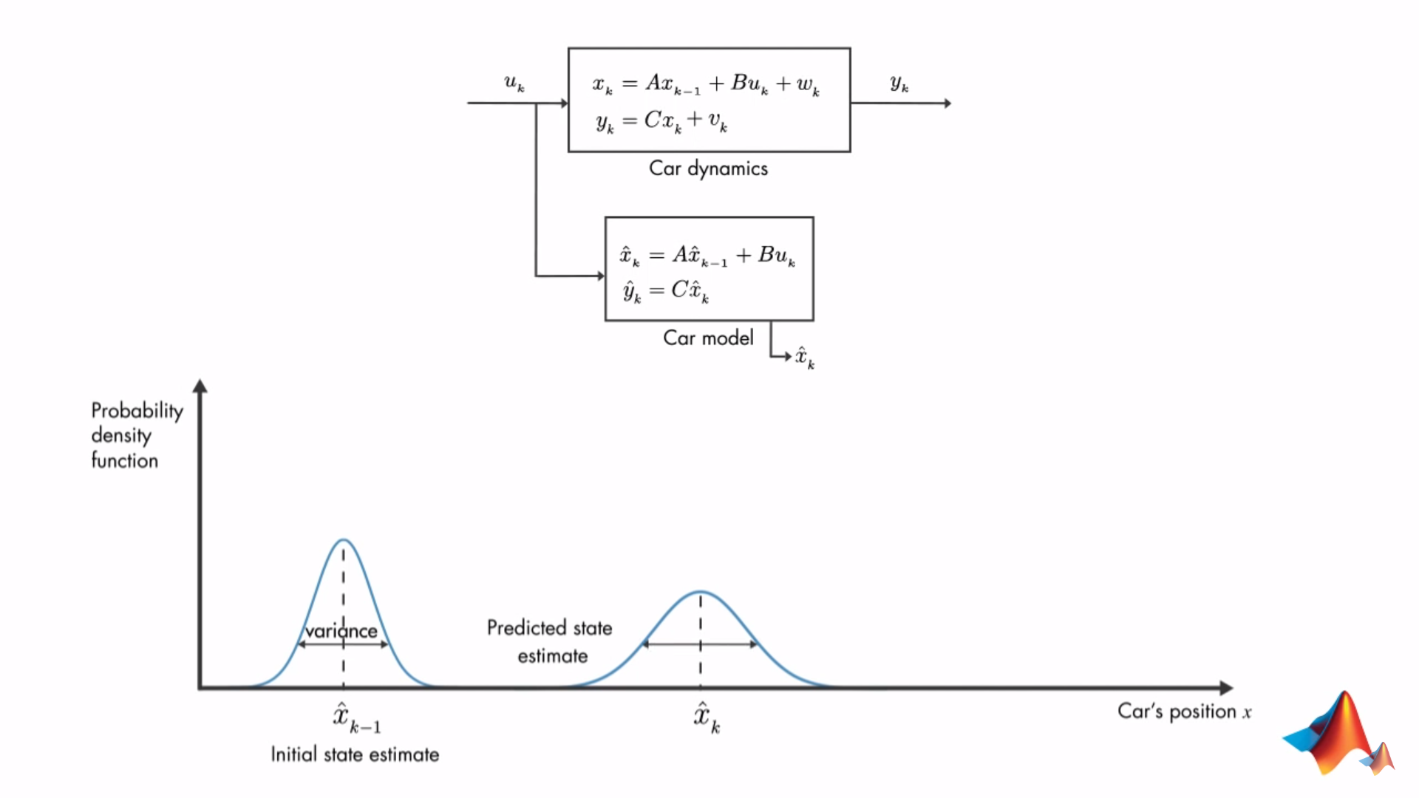

[10]
Intro to NWP – Data assimilation
Future of NWP – Contents
Slide: 39/52
Slide: 2/

Slide 40
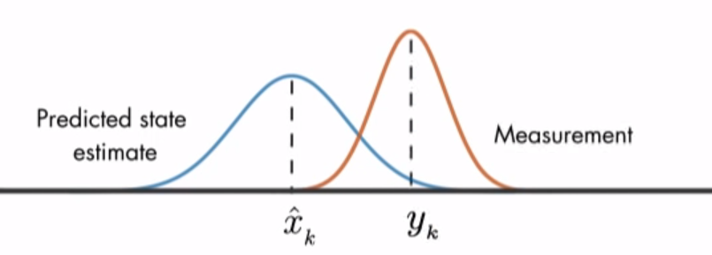
[10]
Intro to NWP – Data assimilation
Future of NWP – Contents
Slide: 40/52
Slide: 2/

Slide 41
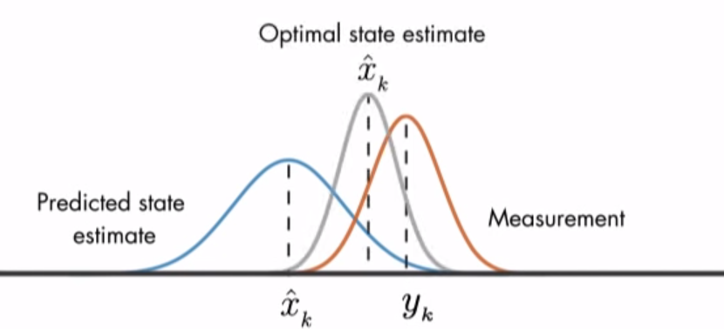
[10]
Intro to NWP – Data assimilation
Future of NWP – Contents
Slide: 41/52
Slide: 2/

Slide 42
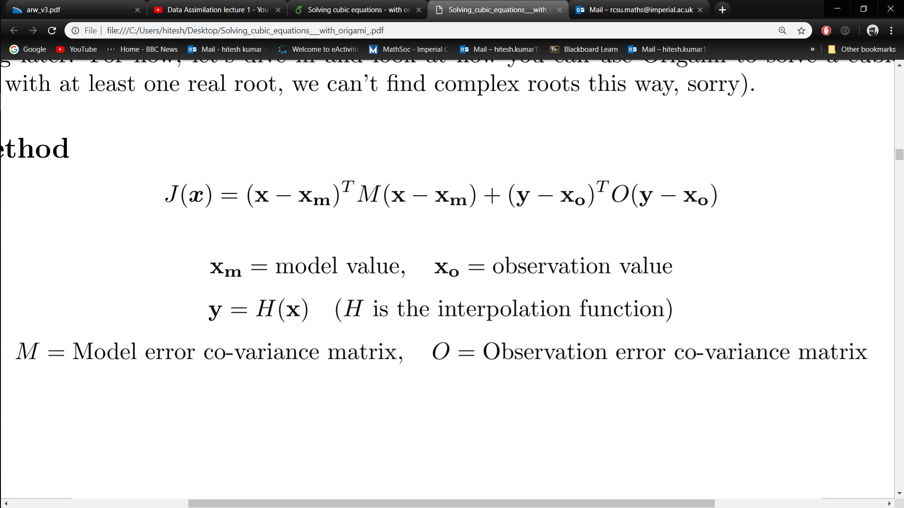
Intro to NWP – Data assimilation
Future of NWP – Contents
Slide: 42/52
Slide: 2/

Slide 43
Contents:
The fundamental process – start to end
Domain setup + interpolation
Finding IC’s and BC’s
Governing equations
Model discretisation
Some results
Cumulative precipitation – Indian monsoon
Hurricane tracking - Florence
Problems and some solutions
Accuracy of initial conditions - Data assimilation
Post processing - Quantile mapping
Using the software (VM)
Future of NWP – Contents
Intro to NWP – Quantile mapping
Slide: 2/
Slide: 43/52

Slide 44
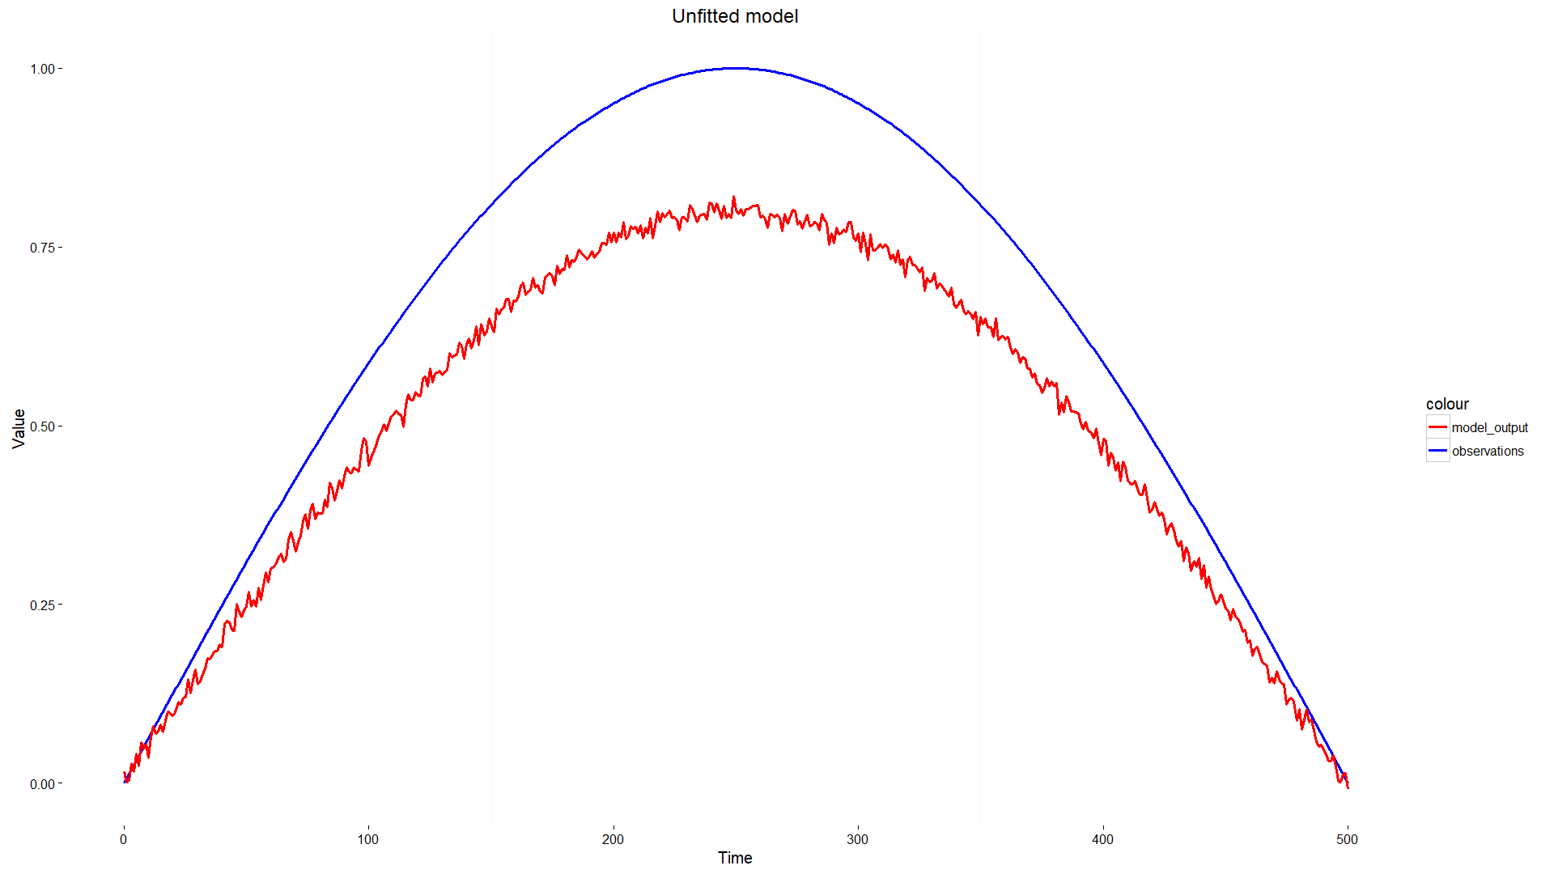
Post-processing of time series data
Future of NWP – The fundamental process – Finding IC’s/BC’s
Intro to NWP – Quantile mapping
Slide: 2/
Slide: 44/52

Slide 45
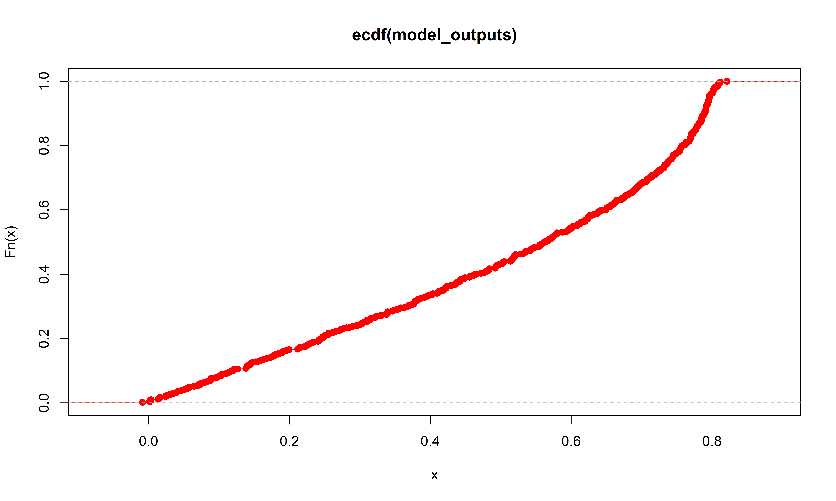
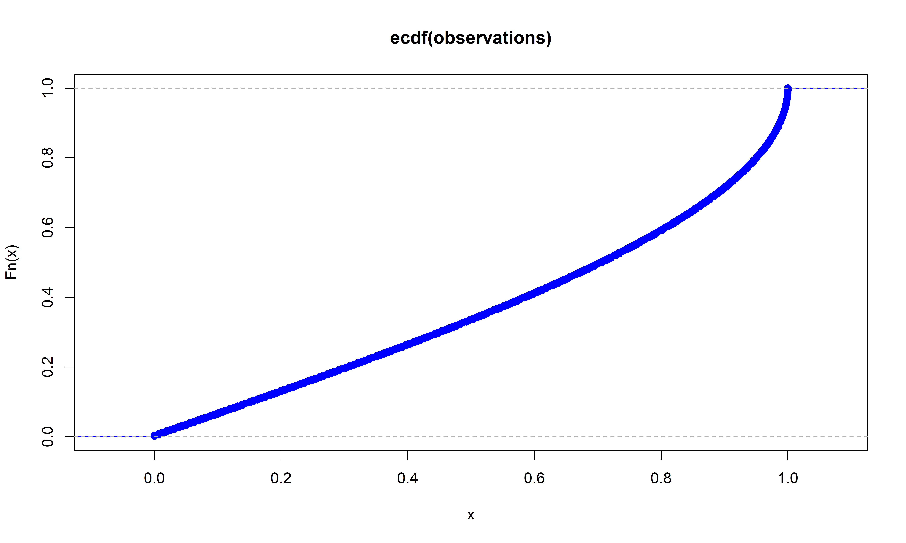
Future of NWP – The fundamental process – Finding IC’s/BC’s
Intro to NWP – Quantile mapping
Slide: 2/
Slide: 45/52

Slide 46
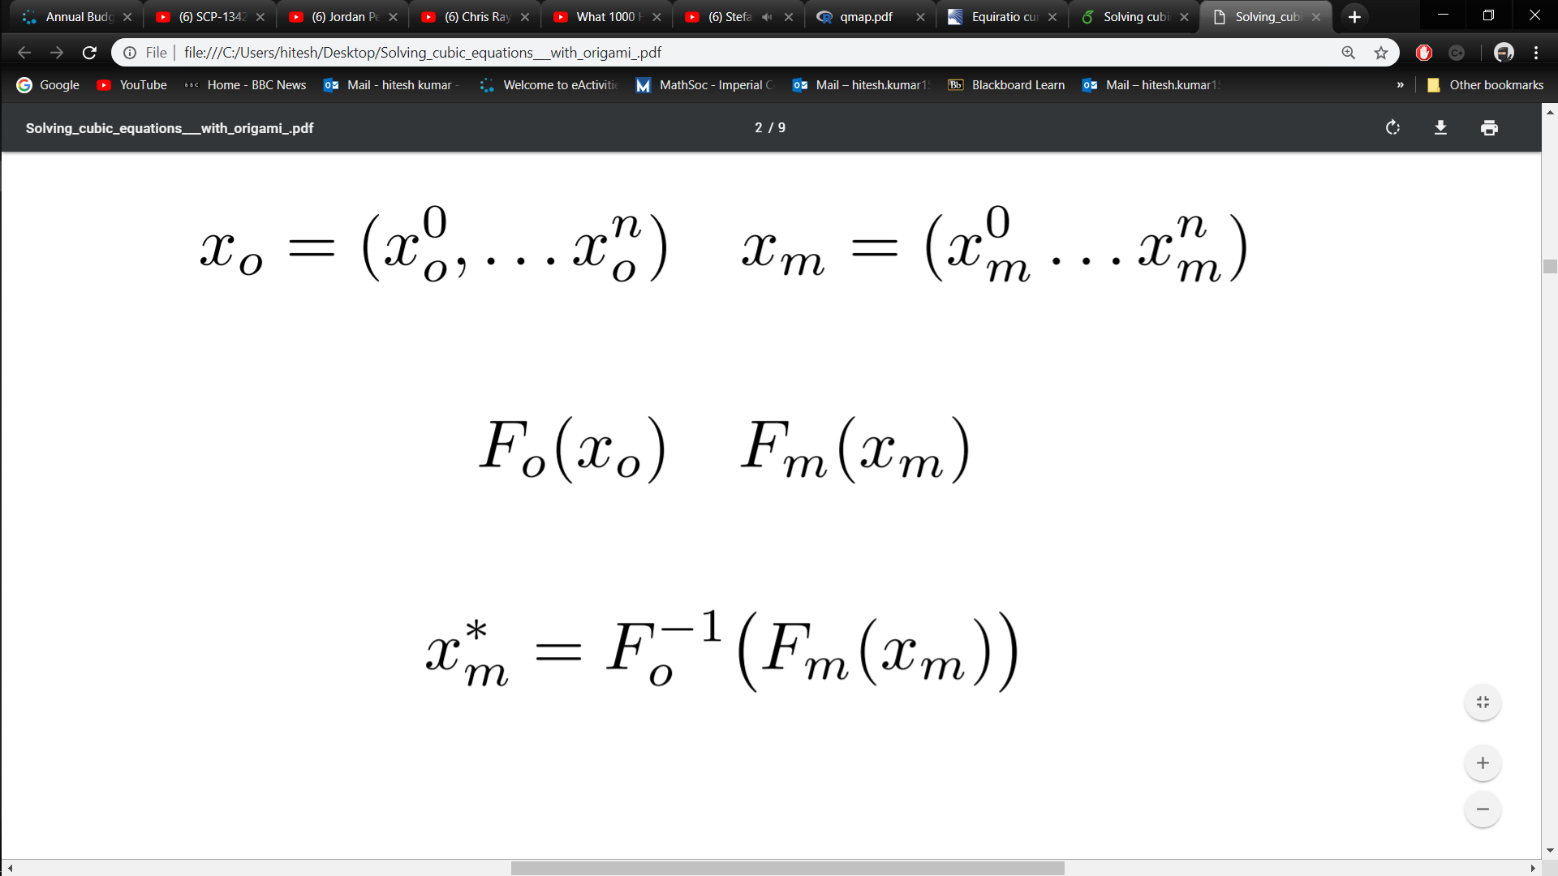
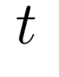
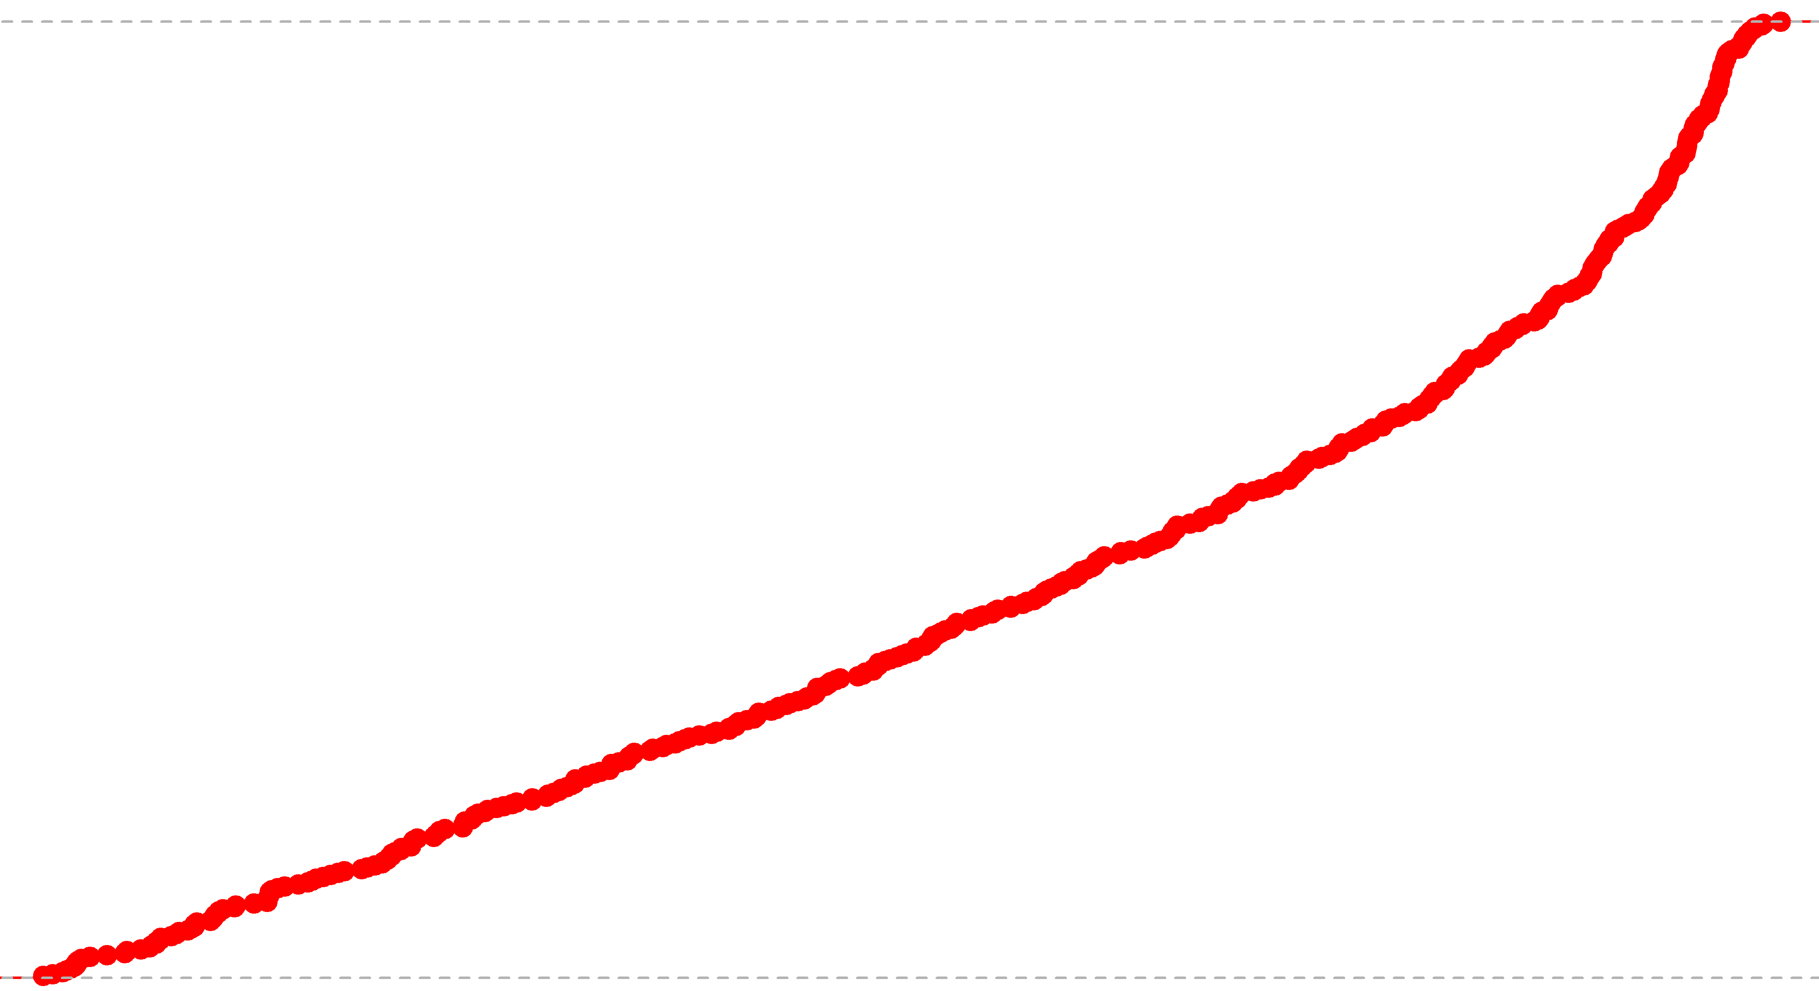
Future of NWP – The fundamental process – Finding IC’s/BC’s
Intro to NWP – Quantile mapping
Slide: 2/
Slide: 46/52

Slide 47
Future of NWP – The fundamental process – Finding IC’s/BC’s
Intro to NWP – Quantile mapping
Slide: 2/
Slide: 47/52

Slide 48
Future of NWP – The fundamental process – Finding IC’s/BC’s
Intro to NWP – Quantile mapping
Slide: 2/
Slide: 48/52

Slide 49
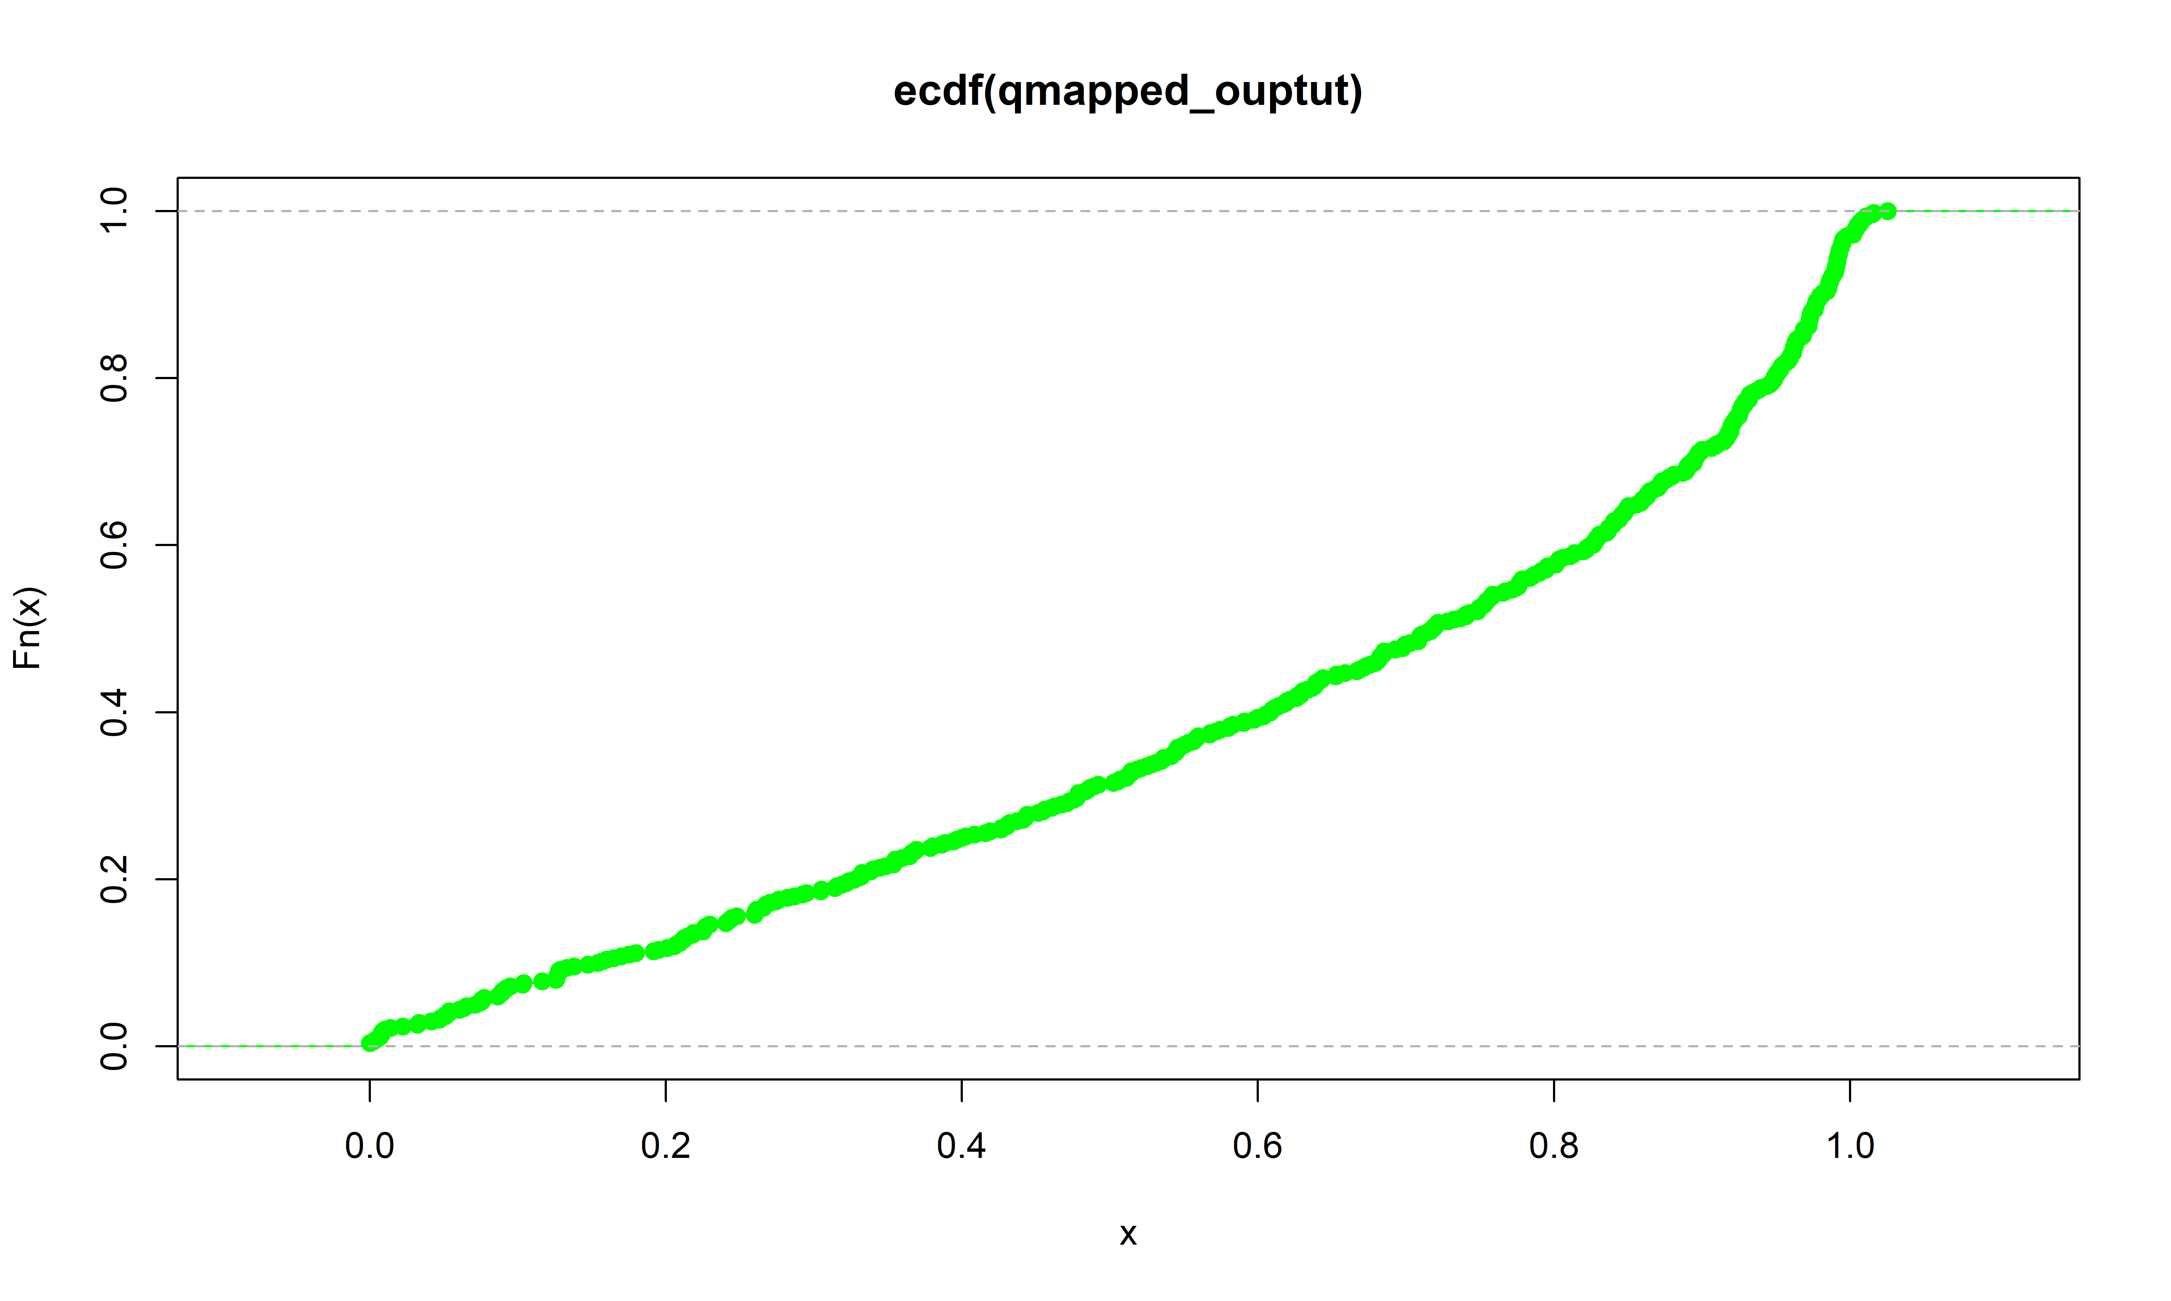
Future of NWP – The fundamental process – Finding IC’s/BC’s
Intro to NWP – Quantile mapping
Slide: 2/
Slide: 49/52

Slide 50
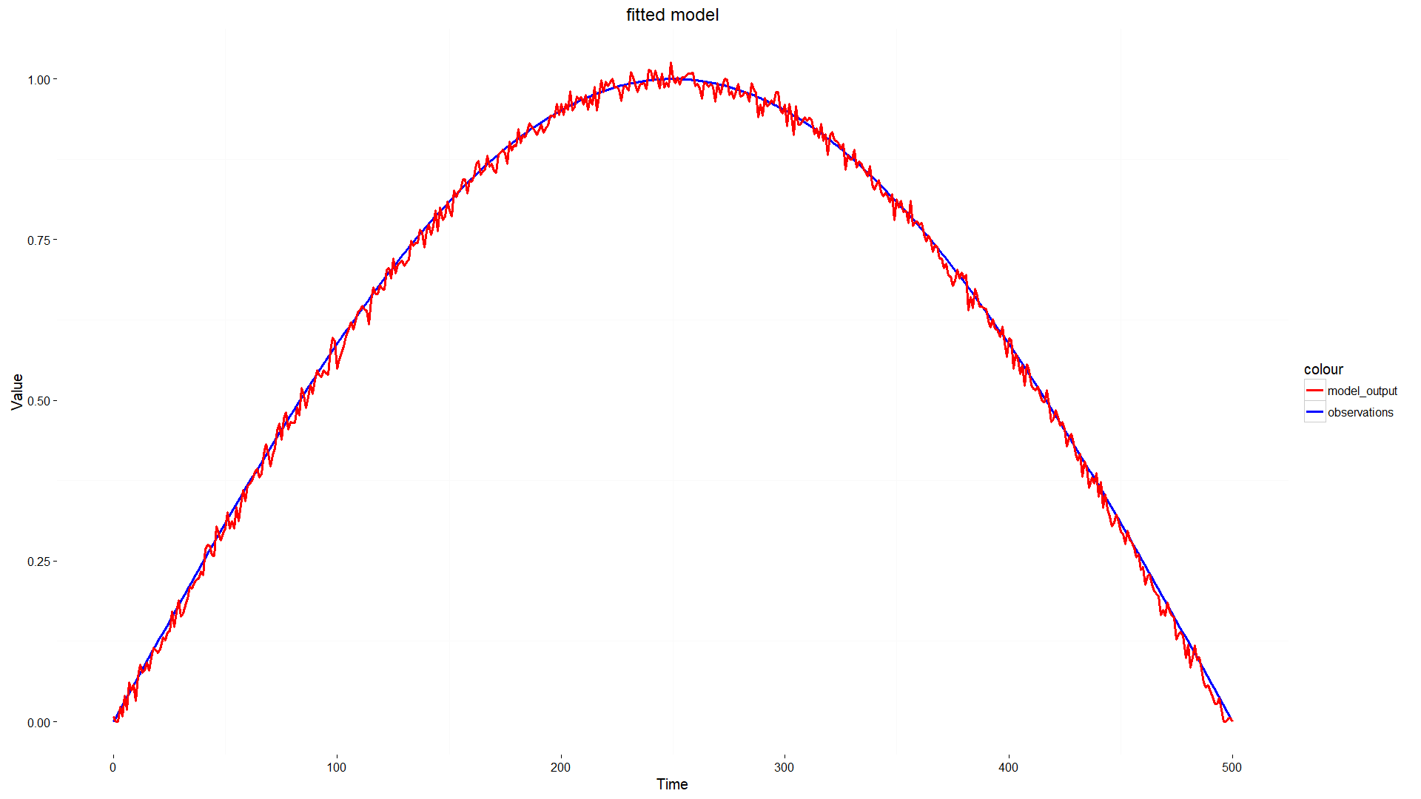
Future of NWP – The fundamental process – Finding IC’s/BC’s
Intro to NWP – Quantile mapping
Slide: 2/
Slide: 50/52

Slide 51
Contents:
The fundamental process – start to end
Domain setup + interpolation
Finding IC’s and BC’s
Governing equations
Model discretisation
Some results
Cumulative precipitation – Indian monsoon
Hurricane tracking - Florence
Problems and some solutions
Accuracy of initial conditions + Data assimilation
Post processing + Quantile mapping
Using the software (VM)
Intro to NWP – Using the software (Virtual Machine)
Future of NWP – Contents
Slide: 51/52
Slide: 2/

Slide 52
References:
[1]: William C. Skamarock, Joseph B. Klemp, Jimy Dudhia, David O. Gill, Dale M. Barker, Michael G. Duda, Xiang-Yu Huang Wei Wang, Jordan G. Powers - 2008 - A description of the advanced research WRF V3 - p.7
[2]: Wei Wang, Cindy Bruyère, Michael Duda, Jimy Dudhia, Dave Gill, Michael Kavulich, Kelly Keene, Ming Chen, Hui-Chuan Lin, John Michalakes, Syed Rizvi, Xin Zhang, Judith Berner, Soyoung Ha, Kate Fossell- WRF users guide V3.9- p.(3-11)
[3]: Robert Israel – 2003 - Mercator's Projection
[4]: William C. Skamarock, Joseph B. Klemp, Jimy Dudhia, David O. Gill, Dale M. Barker, Michael G. Duda, Xiang-Yu Huang Wei Wang, Jordan G. Powers - 2008 - A description of the advanced research WRF V3 - p.53
[5]: William C. Skamarock, Joseph B. Klemp, Jimy Dudhia, David O. Gill, Dale M. Barker, Michael G. Duda, Xiang-Yu Huang Wei Wang, Jordan G. Powers - 2008 - A description of the advanced research WRF V3 - p.19
[6]: Hugo Coussens (Team Pacific, ACSE 2018/19, Imperial College London) – 20/01/2019
[7]: India meteorological department – 20/01/2019 – Insat3D
[8]: The Washington Post – 13/09/2018 - Tracking Hurricane Florence
[9]: NCAR RDA – 22/01/2019 - NCEP ADP Global Upper Air Observational Weather Data, October 1999 - continuing
[10]: Understanding Kalman Filters, Part 1: Why Use Kalman Filters? – 22/01/2019 – YouTube - MATLAB
Intro to NWP – References
Future of NWP – Contents
Slide: 52/52
Slide: 2/

